Slide 1
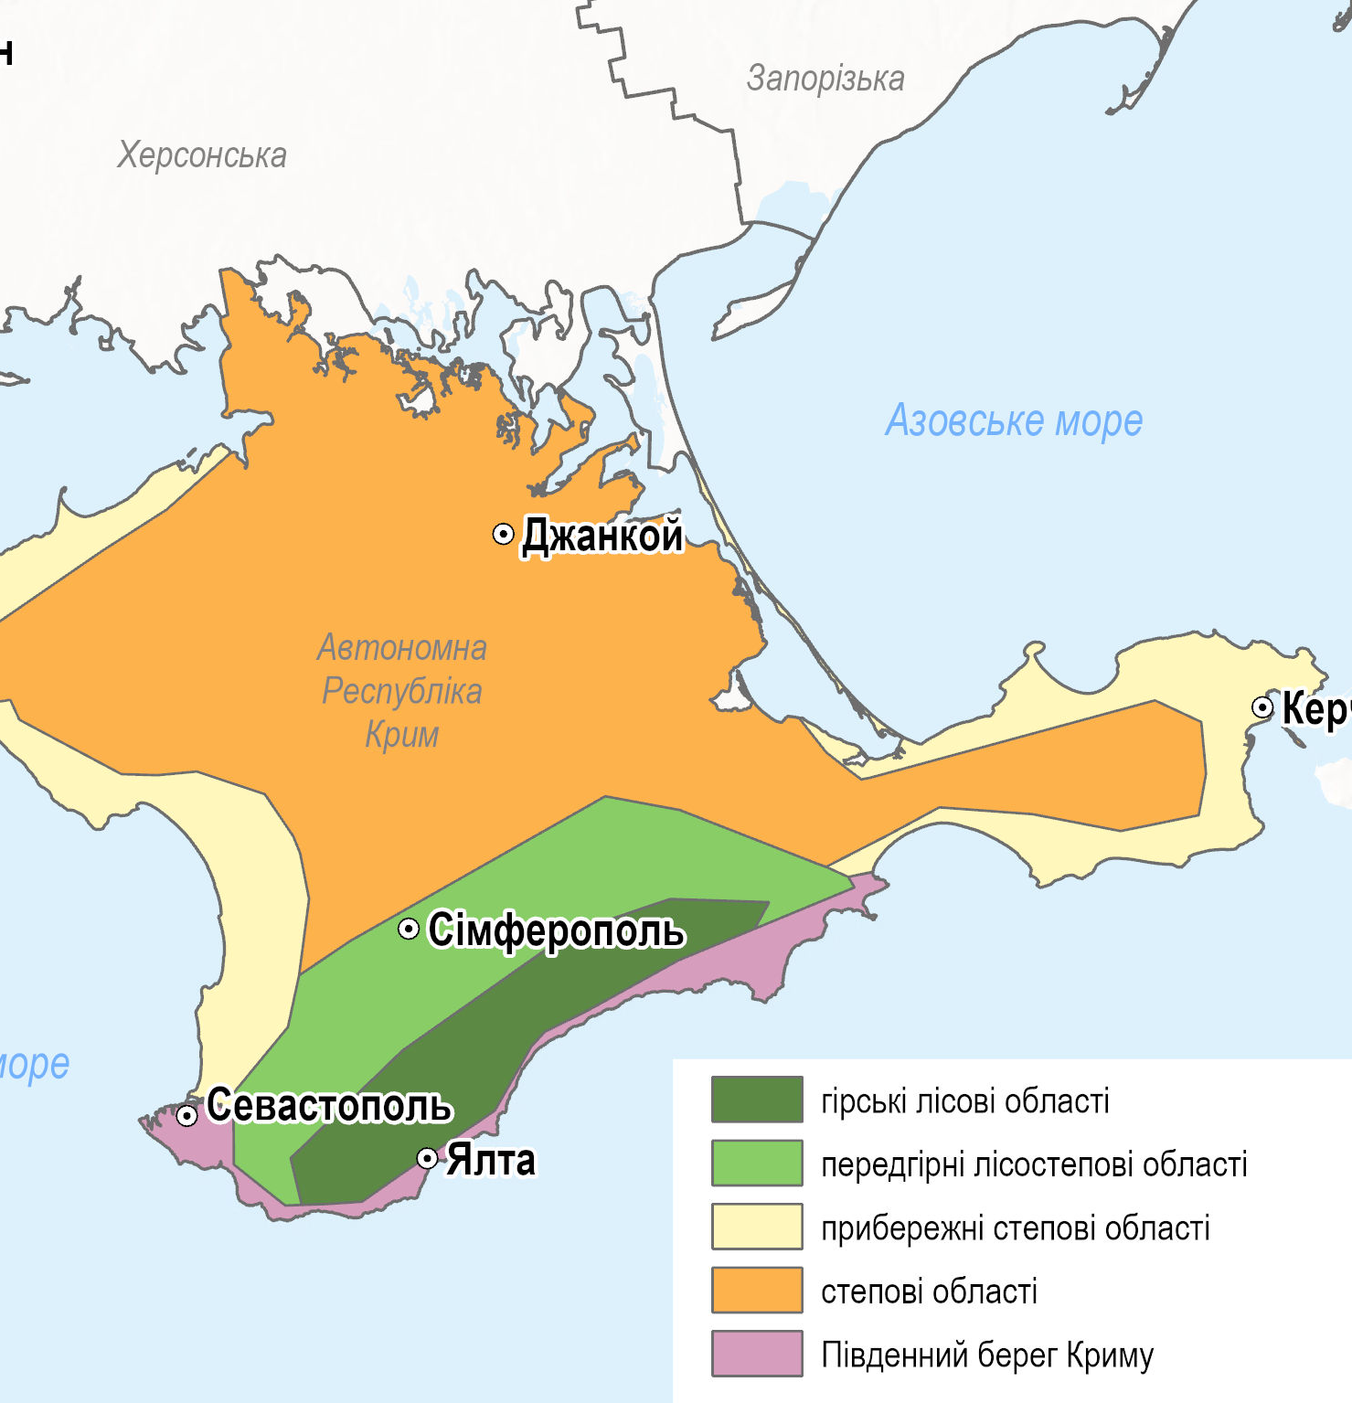
Crimea: challenges, threats, solutions
Svitlana Boychenko ^{1,3}, Tetyana Kuchma ^{2,3}
¹ S.I. Subbotin Institute of Geophysics of the NAS of Ukraine,
² Institute of Agroecology and Environmental Management,
³ National University of Kyiv–Mohyla Academy,
The studies were carried out under the projects, which is implemented by the International Renaissance Foundation with the financial support of the Government of Sweden and Baltic University Programme (Uppsala, Sweden).

Slide 2
Materials and Methods
It should be noted that Ukraine does not have access to the environmental monitoring data on the peninsula’s territory since 2014. Since the data from gauging stations are not received by the Central Geophysical Observatory of Ukraine (CGO), our research was based on the remote sensing data analysis. In particular, as the water level data is not available, we used microwave satellite data to estimate the water body area dynamics of the reservoirs and to detect the standing water areas after the heavy rain events potentially related to the active influences on atmosphere.
Sentinel–1 satellite radar (microwave) sensor data was used for surface water area detection. Microwave sensors are sensitive to the surface structure and roughness: the smoother the surface, the lower signal scattering. The smooth water surface acts as a mirror reflector, which makes radar sensing effective in detecting the boundaries of water bodies. All available satellite images for the full–year period from 2015 to 2021 were analysed in this study. Fifteen significant reservoirs of the Crimean Peninsula that provide water supply to the population were included in the assessment.
As the scope of this research has not included the satellite image processing methodology development and verification, we applied step–by–step procedures, so–called Recommended Practices, developed by UN–SPIDER, that have proven effective in creating information products based on remote sensing to assess hazards such as floods, drought etc. UN–SPIDER stands for the United Nations Platform for Space–based Information for Disaster Management and Emergency Response, is a platform which facilitates the use of space–based technologies for disaster management and emergency response.

Slide 3
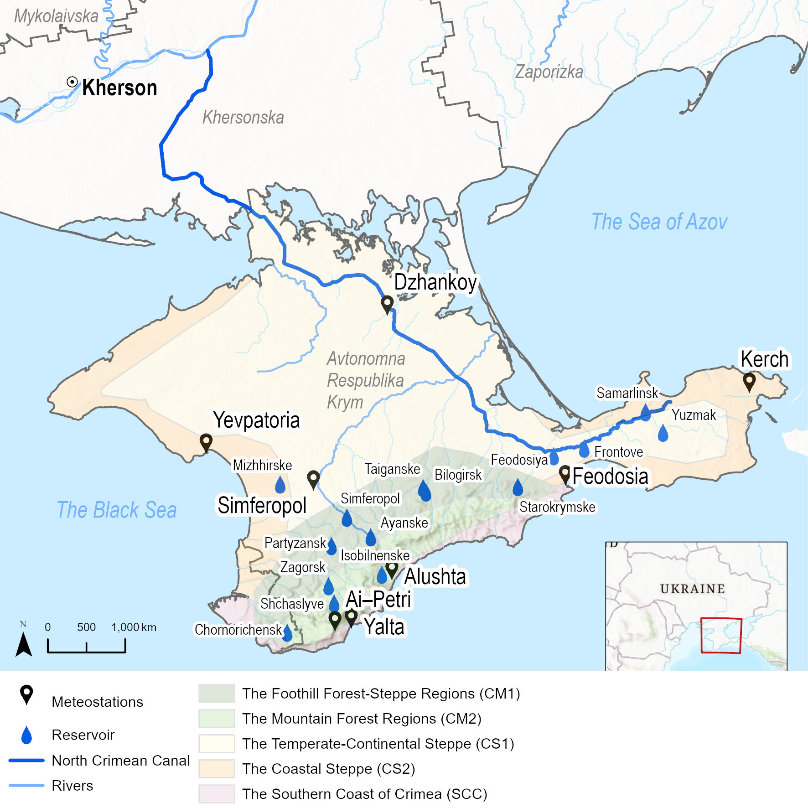
Climatic subzones of the Crimean Peninsula, the locations of meteostations and the reservoirs
Climatic conditions on the peninsula have some differences and therefore three climatic subzones are distinguished:
Mountain Crimea (MC) has a temperate–continental climate, with pronounced seasonality, vertical zonation, with a significant recurrence of strong winds, most of the year excessive humidity, with some differences depending on altitude sea and exposure slopes, and proximity to the Black Sea. The temperate–continental climate of foothill forest–steppe regions (MC1) and mountain forest regions (MC2) has specific differences.
Steppe Crimea (SC) is a temperate–continental climate with pronounced seasonality. The driest region on the peninsula with hot, arid summers and short snowless winters with frequent thaws and very changeable weather (occupies 2/3 of the peninsula). The temperate–continental steppe (SC1) and coastal steppe (SC2) climates have some differences.
The Southern Coast of Crimea (SCC) is a subtropical Mediterranean climate with the influence of breeze circulation and less pronounced seasonality. According to climatic conditions, the South Coast is divided into two parts: the eastern part (from Alushta to Feodosia) and the western part (from Cape Aya to Alushta).

Slide 4
Comparison of climatic norms of annual average temperature and precipitation and their trends for respective the meteostations of the Crimean Peninsula for the periods 1961–1990 and 1991–2020
Stations | Temperature, °C |  |  | Precipitation, mm/year
 | 1961–1990 | 1991–2020 |  | 1961–1990 | 1991–2020
 | <T> ±σ, ^{о}C/year | <T> ±σ, ^{о}C/years | T_{trn}, ^{о}C/10 years* | <P> ±σ, mm/years | <P> ±σ mm/years | P_{trn}, mm/10 years*
Ai–Petri | 5.7 ± 0.6 | 6.5 ± 1.0 | +0.88 | 1080 ± 260 | 990 ± 257 | –44
Alushta | 12.1 ± 0.6 | 13.3 ± 1.2 | +1.21 | 476 ± 103 | 447 ± 99 | –2
Dzhankoy | 10.7 ± 0.9 | 11.7 ± 0.9 | +0.84 | 417 ± 79 | 405 ± 128 | –3
Kerch | 11.0 ± 0.8 | 11.9 ± 1.0 | +0.87 | 434 ± 76 | 430 ± 129 | –61
Yevpatoria | 11.5 ± 0.8 | 12.6 ± 0.9 | +0.82 | 404 ± 78 | 370 ± 83 | –26
Simferopol | 10.6 ± 0.8 | 11.4 ± 0.9 | +0.84 | 505 ± 93 | 501 ± 133 | –22
Feodosia | 11.9 ± 0.8 | 12.8 ± 0.8 | +0.65 | 449 ± 99 | 475 ± 114 | –47
Yalta | 12.9 ± 0.8 | 13.8 ± 0.9 | +0.83 | 628 ± 164 | 591 ± 144 | –22

Slide 5
The annual average temperature (A) and the annual amount of precipitation (B) for the Crimean Peninsula
Seasonal variation of temperature (A) and precipitation (B)
(the values of the climatic norm for the whole region for the periods 1991–2020 (1) and 1961–1990 (2) (scale on the left), the values of linear trend for the period 1991–2020 (scale on the right)). Statistically significant trends (p < 0.05).
(1—empirical data, 2—linear trend for the period 1900–2021, 3—±σ from trend, 4—linear trend for the period 1991–2020). Statistically significant trends (p < 0.05).

Slide 6
Assessment of aridization of climatic conditions on the Crimean Peninsula in summer using ground and satellite data

Slide 7
The anomaly average monthly temperature (1) and precipitation (2) during the summer months in Crimea (1а and 2a are linear trends, accordingly) for the period 1991–2021.
Frequency distribution of precipitation in summer months by gradations
(<25; 26-50; 51-75; 76-100; 101-300 mm per month) recorded at meteostations of Crimea for the period 1991-2021

Slide 8
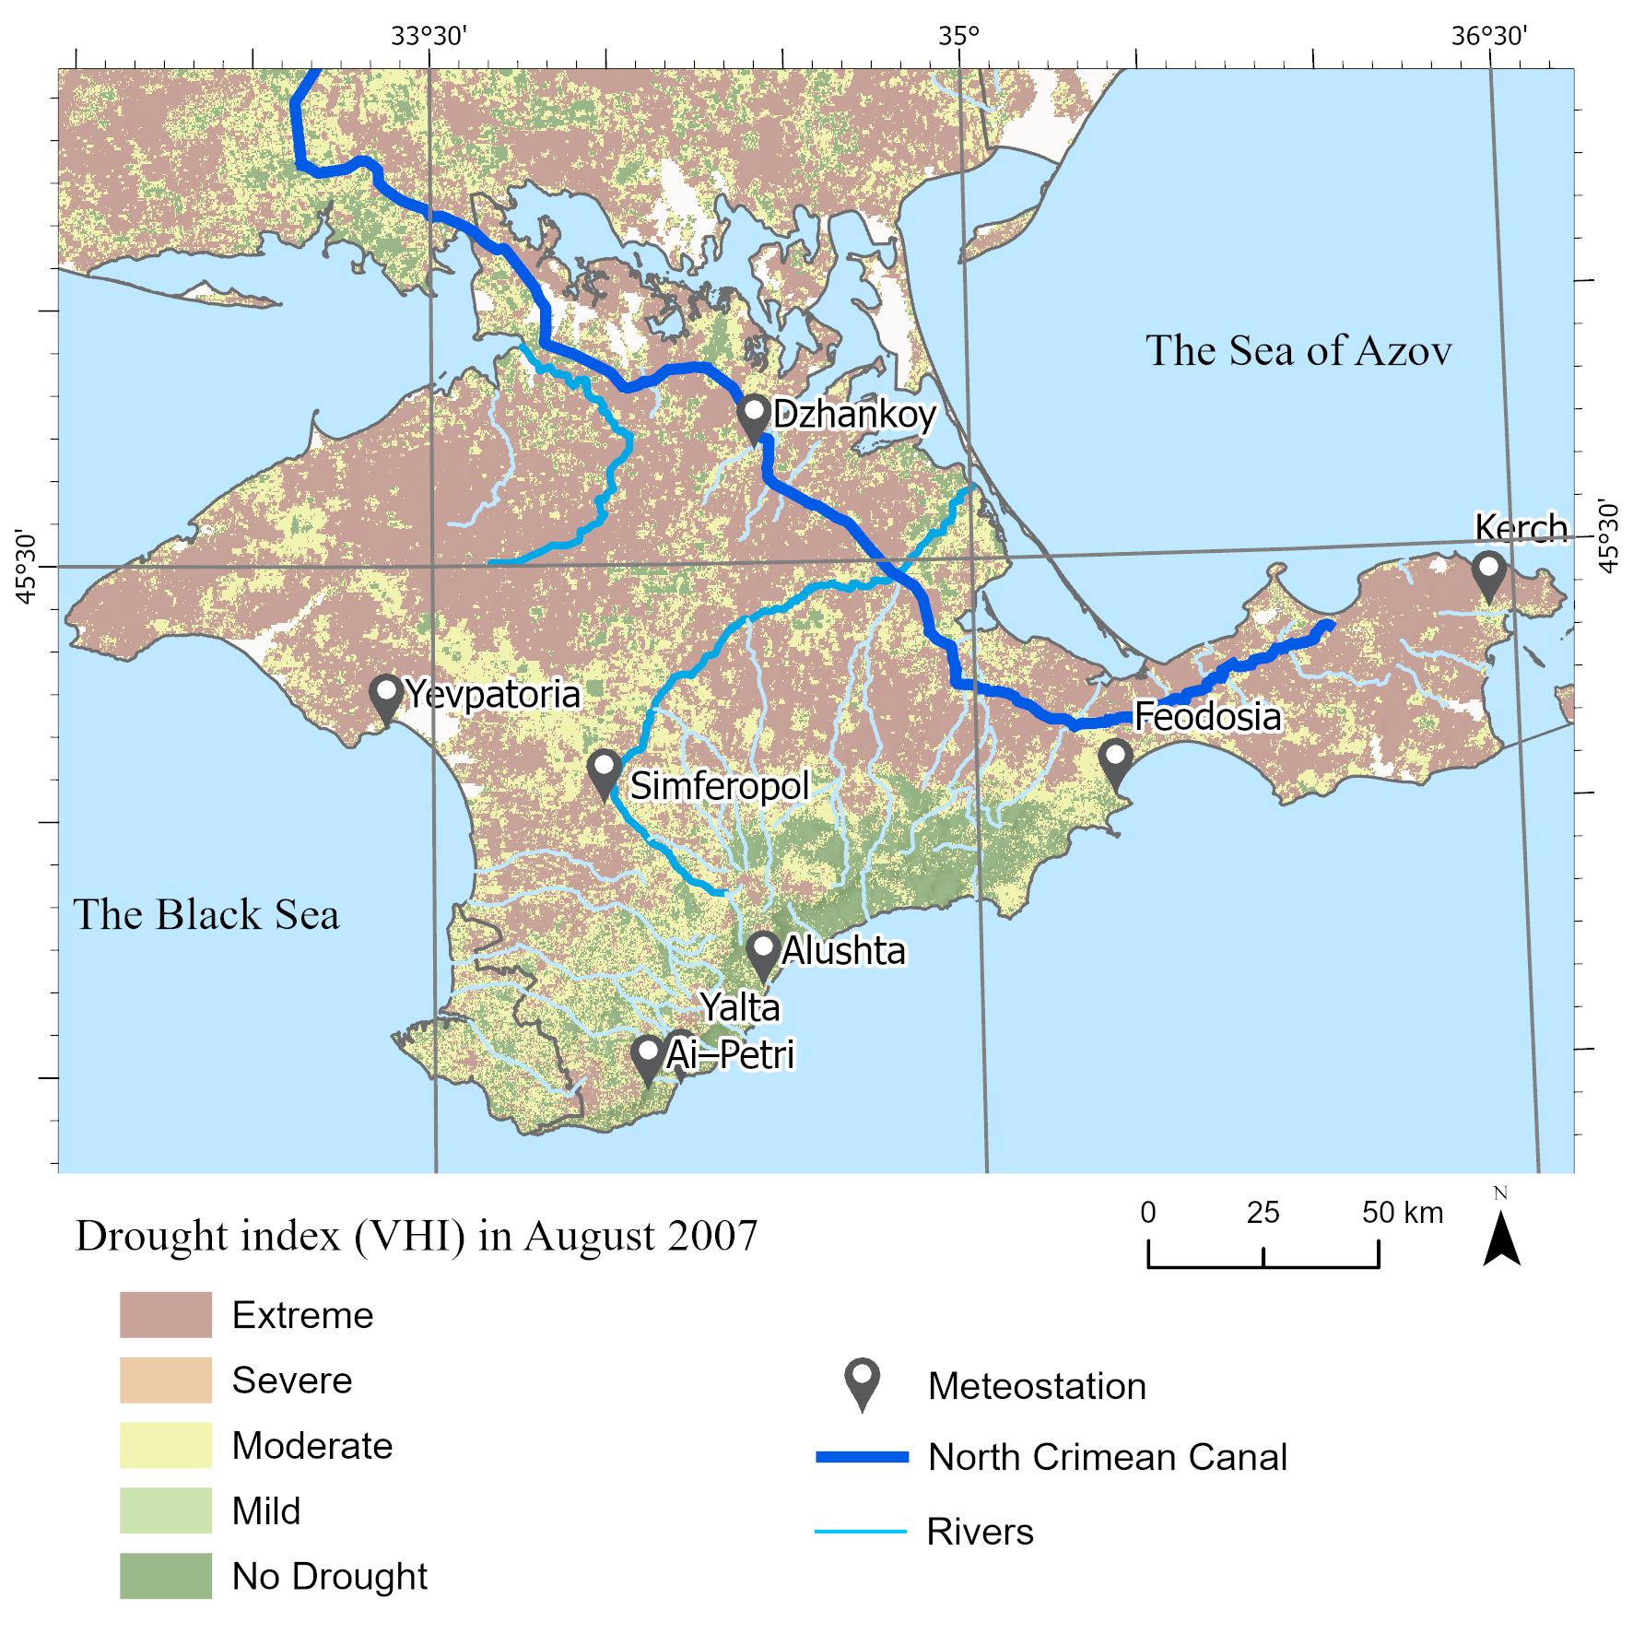
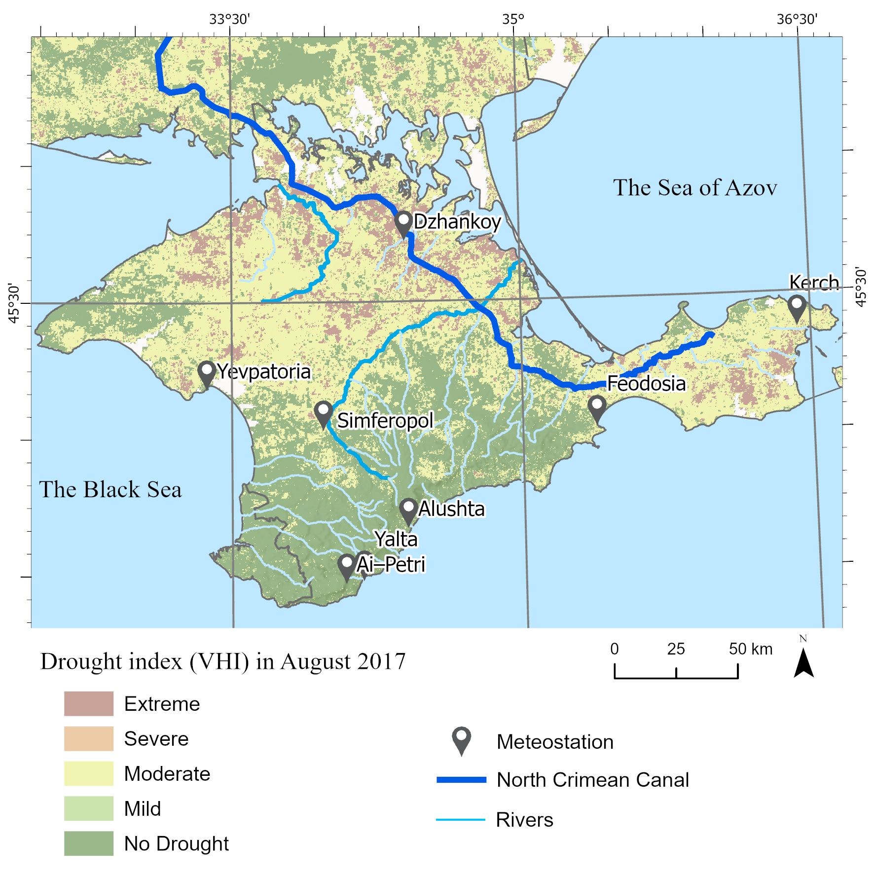
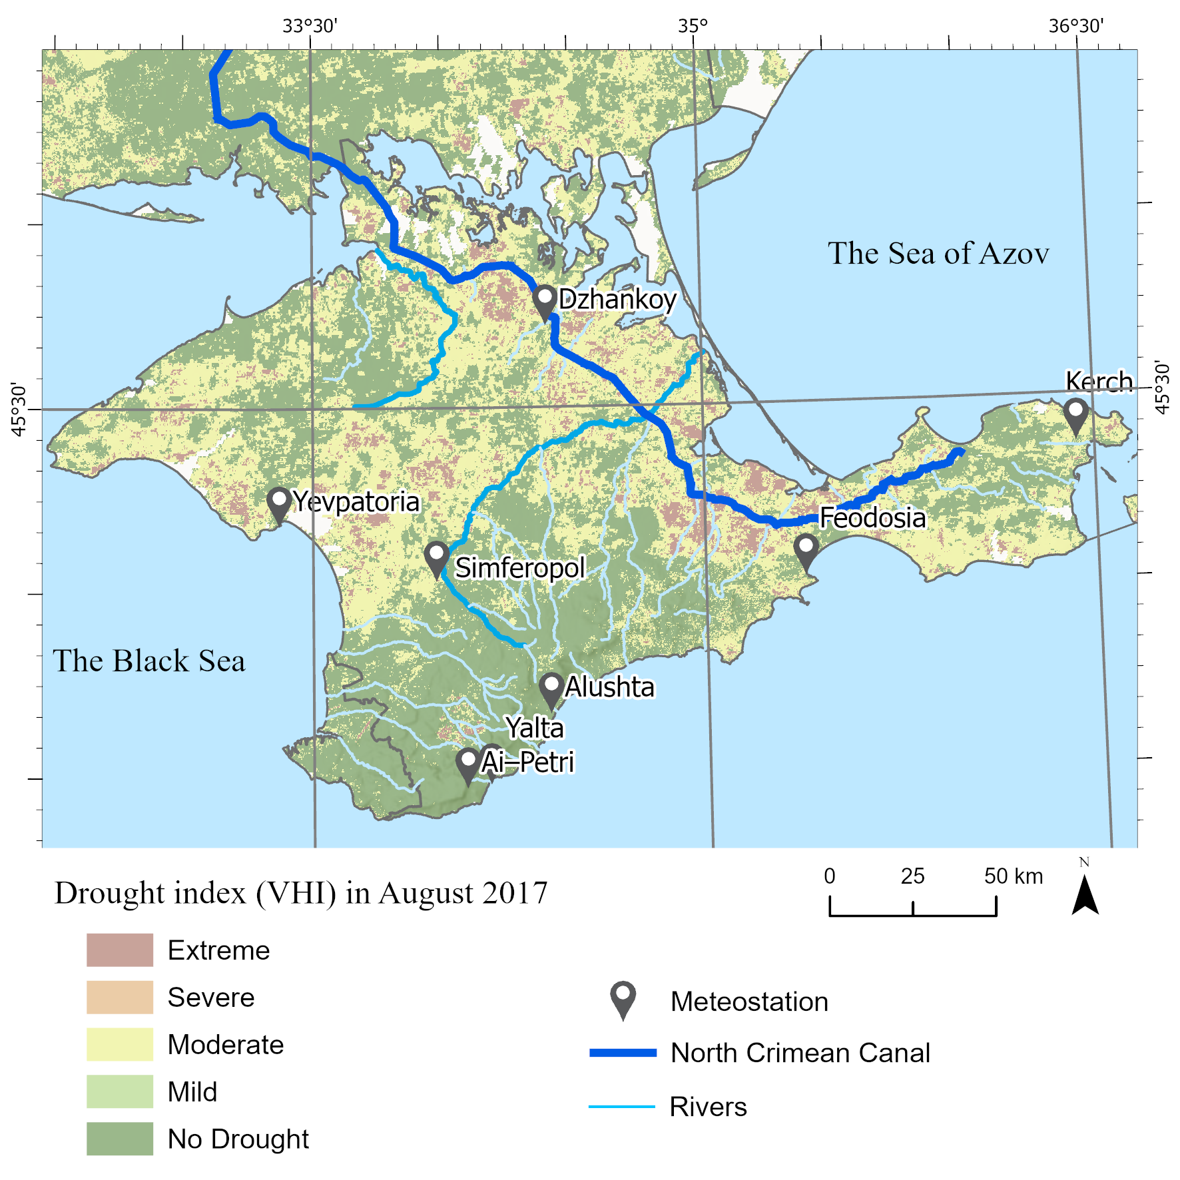
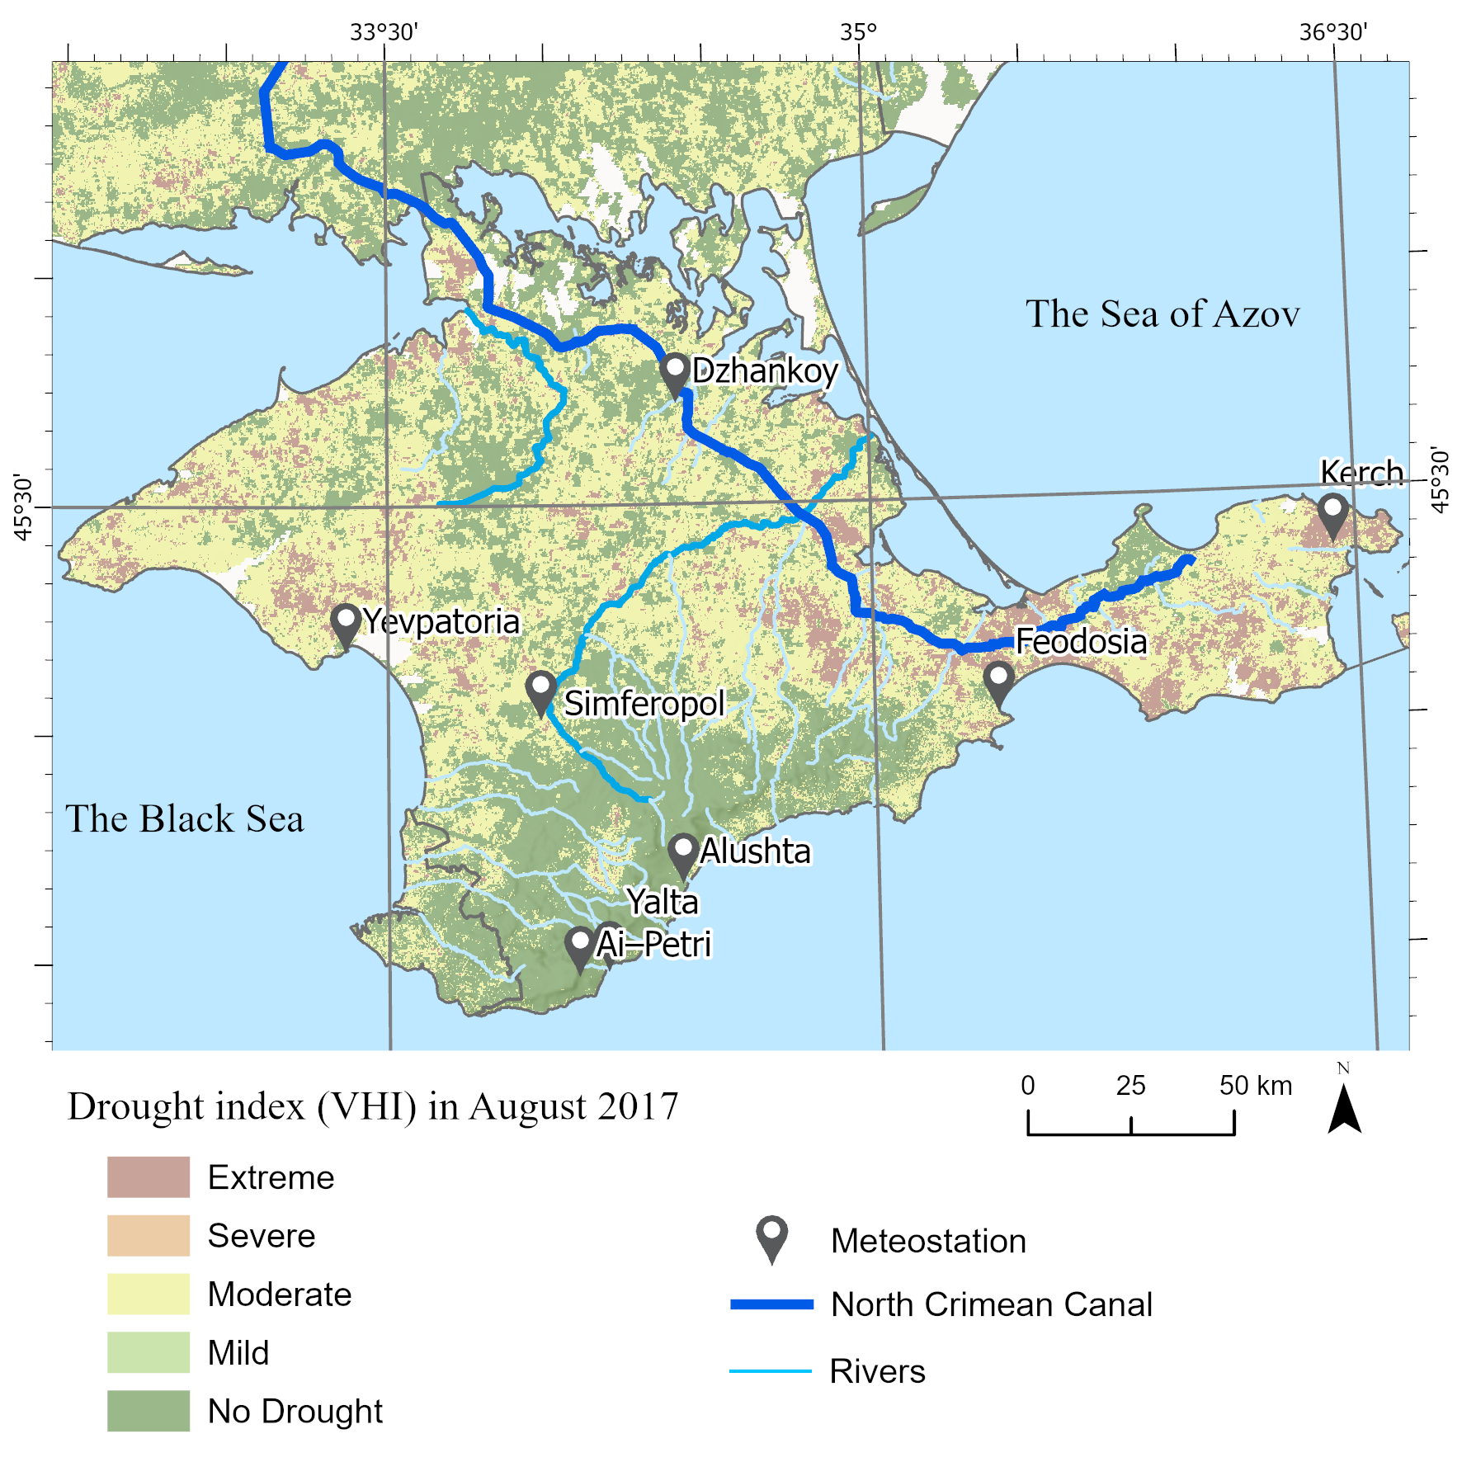
Drought index from summed vegetation health index (VHI) in summer (in August 2007, 2017, 2018 and 2020) on the Crimean Peninsula
Drought severity classification was made according to the recommended VHI threshold’s values
(<10-extreme drought, 11–20-severe drought, 21–30-moderate drought, 31–40-mild drought, >40-no drought)
Areas of extreme drought conditions are also observed in the Northern coastline area of the Crimean Peninsula. Minor areas in the mountainous part of the Crimea also have signs of arid conditions, but for the most part the condition of vegetation in this area is satisfactory.
In percentage terms, in 2007 VHI values of extreme and severe drought occupied 57% and 20% of the peninsula’s area accordingly, as well 10% and 29% in 2017, 7% and 22% in 2018 and 11% and 26% in 2020

Slide 9
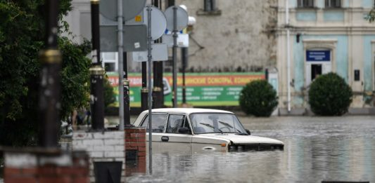
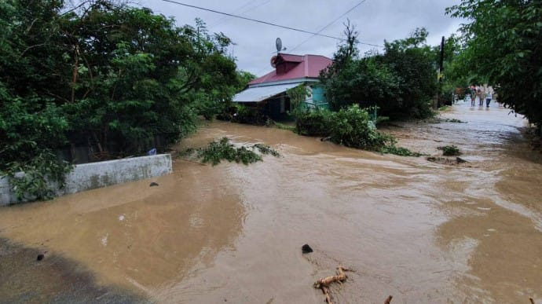
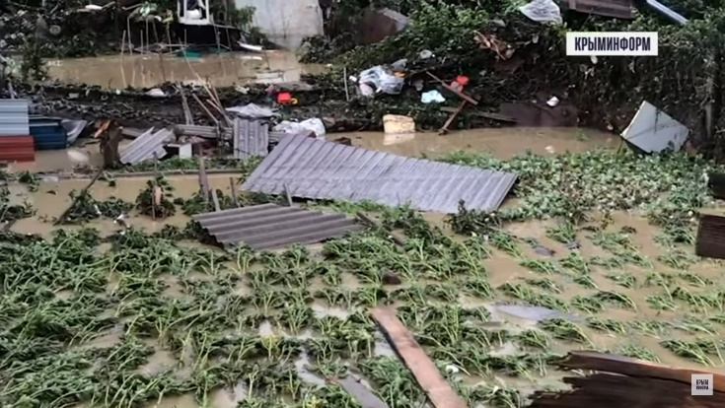
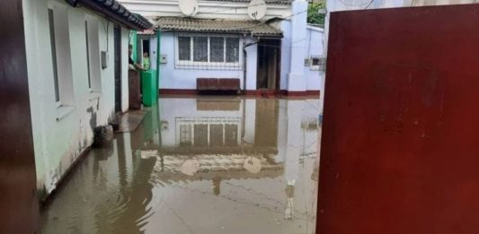
Abnormal weather phenomena in the summer of 2021
On the territory of Crimea in the summer of 2021, several heavy downpours were recorded, which provoked floods and mudslides, and as a result, a number of large cities and towns were in the zone of a natural disaster (Yalta and Kerch, June 17-18, 2021; Bakhchisar, Yalta, Saki, etc., July 3-7, 2021, etc.).
For example, on July 3-7, 113 mm of precipitation fell in a day in the Bakhchisaray district, in Yalta 49 mm, in Ai-Petri 85 mm, in Nikitsky-Sadi 42 mm, in Simferopol 35 mm (from 0.5 to 2 monthly precipitation rates).
According to hydrologists of the Crimea, intense rainfall in June-July on the peninsula had a positive effect on the filling of reservoirs, but there are questions about the quality of these waters, which are a mixture of dirt and sewage.
But at the same time, in Alushta, thanks to the fact that the drainage system was repaired and unclogged, the rains passed almost without consequences.

Slide 10
Change in the Water Surface Area of Reservoir of the Crimea According to Radar Satellite data Sentinel–1 for the Period 2015–2021

Slide 11
Comparison of the water mirror areas of the reservoirs in Crimea in 2015–2021 according to radar satellite data Sentinel–1
Reservoir name | Yearly Averaged Water Mirror Area of Reservoir, (ha)
 | 2015-2021 | 2015 | 2016 |  | 2017 |  | 2018 |  | 2019 |  | 2020 |  | 2021
The loading reservoirs
Feodosiya | 153.5 | 177.0 | 164.5 | –7% | 159.7 | –10% | 157.9 | –11% | 150.8 | –15% | 150.6 | –15% | 113.9 | –36%
Frontove | 216.2 | 341.8 | 276.2 | –19% | 235.3 | –31% | 195.0 | –43% | 168.8 | –51% | 169.2 | –51% | 127.4 | –63%
Yuzmak | 111.5 | 124.0 | 111.0 | –11% | 105.0 | –15% | 105.4 | –15% | 111.3 | –10% | 117.3 | –5% | 106.4 | –14%
Mizhhirske | 60.5 | 116.2 | 73.7 | –37% | 49.2 | –58% | 52.5 | –55% | 35.0 | –70% | 76.1 | –35% | 21.1 | –82%
Samarlinsk | 97.8 | 109.6 | 99.4 | –9% | 97.9 | –11% | 95.9 | –13% | 96.4 | –12% | 96.4 | –12% | 89.0 | –19%
The natural runoff reservoirs
Chornorichensk | 425.3 | 452.8 | 401.5 | –11% | 452.2 | 0% | 473.2 | +5% | 466.6 | +3% | 349.3 | –23% | 381.7 | –16%
Bilogirsk | 119.0 | 142.6 | 106.6 | –25% | 137.5 | –4% | 108.7 | –24% | 145.0 | +2% | 86.2 | –40% | 106.5 | –25%
Partyzansk | 146.7 | 168.1 | 156.1 | –7% | 169.6 | +1% | 165.4 | –2% | 159.8 | –5% | 97.0 | –42% | 110.8 | –34%
Zagorsk | 119.1 | 137.2 | 129.5 | –6% | 130.0 | –5% | 127.3 | –7% | 123.8 | –10% | 84.5 | –38% | 101.2 | –26%
Simferopol | 236.3 | 282.4 | 261.0 | –8% | 269.3 | –5% | 253.5 | –10% | 244.6 | –13% | 175.5 | –38% | 168.0 | –41%
Shchaslyve | 42.6 | 48.1 | 40.0 | –17% | 44.5 | –7% | 43.6 | –11% | 42.6 | –11% | 37.4 | –22% | 42.0 | –13%
Taiganske | 76.8 | 116.7 | 63.3 | –46% | 55.0 | –53% | 37.0 | –68% | 143.4 | +23% | 85.0 | –27% | 36.9 | –68%
Isobilnenske | 50.0 | 52.5 | 55.0 | +5% | 54.8 | +5% | 53.4 | +2% | 53.1 | +1% | 43.6 | –17% | 37.3 | –29%
Ayanske | 25.2 | 28.2 | 24.1 | –15% | 26.8 | –5% | 25.4 | –10% | 24.3 | –14 | 22.0 | –22% | 25.3 | –10%
Starokrymske | 23.0 | 20.8 | 17.4 | –17% | 28.1 | +35% | 24.7 | +19% | 31.9 | +53% | 24.7 | +18% | 13.2 | –37%

Slide 12
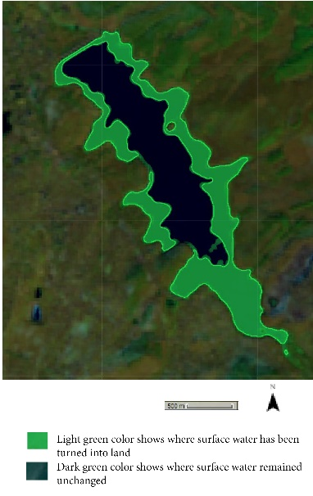
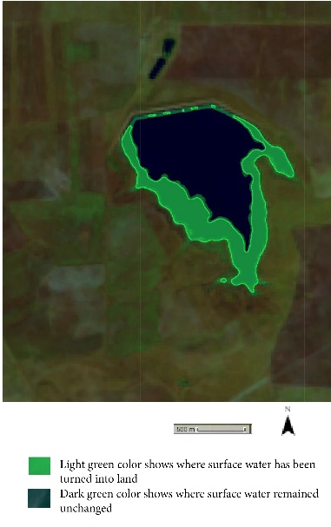
Decrease in the water surface area of the Simferopol and Feodosiya Reservoirs in 2021 (dark green) compared to 2010 (light green) according to Landsat satellite imagery (A) and anomaly of monthly precipitation (1) and anomaly average monthly of temperature (2) for period from January 2014 to August 2022 and dynamics of changes of water surface area (3 and 3a is polynomial spline) for the period from October 2014 to August 2022 according to Sentinel–1 satellite data (B)

Slide 13
The problem of the freshwater scarcity in semi-arid and arid regions is being solved in several ways:

Slide 14
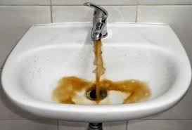
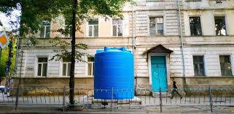
Fresh water shortage in Simferopol
In 2018-2021 (especially in 2020), the critical situation with water supply worsened due to a rather arid and warm winter and hot summer.
Yes, this became the reason for the sharp shallowing of, for example, the Simferopol Reservoir, which is one of the main suppliers of fresh water to the city of Simferopol. With the city's daily drinking water needs of ~160,000 m3, only ~100,000 m3 of water is provided per day.
In addition, due to technical reasons (accidents on water supply networks), more than 50-60% of water is lost on the way to the consumer. All this forced the Crimean authorities to introduce an hourly water supply schedule in the city of Simferopol and 39 other settlements in August of this year, and in some areas, residents receive water only two hours a day and only on weekdays.

Slide 15
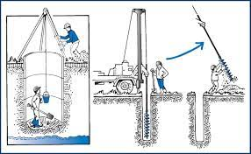
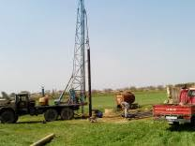
Usage of groundwater resources from wells: The groundwater is the main source of domestic potable water supply in semi-arid regions. Groundwater of the Crimean Peninsula, which comes mainly from karst aquifers, provides about 40% of the water budget and services about 50% of the Crimean population (1.0–1.5 million people). The demand for water resources increases in summer due to the influx of tourists (up to 6 million people), but the average annual demand increased dramatically after 2014. In 2018 alone, about 0.12 km³ of water was extracted from 1204 artesian wells, while the maximum sustainable withdrawal rate is 0.04 km³.
For example, wells have been drilled near Simferopol that can provide up to 10,000 m³ of water per day, but the water is often brackish and needs further treatment.

Slide 16
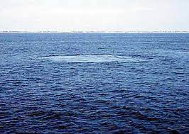
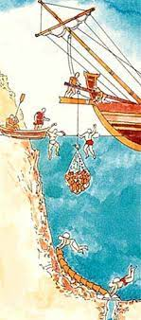
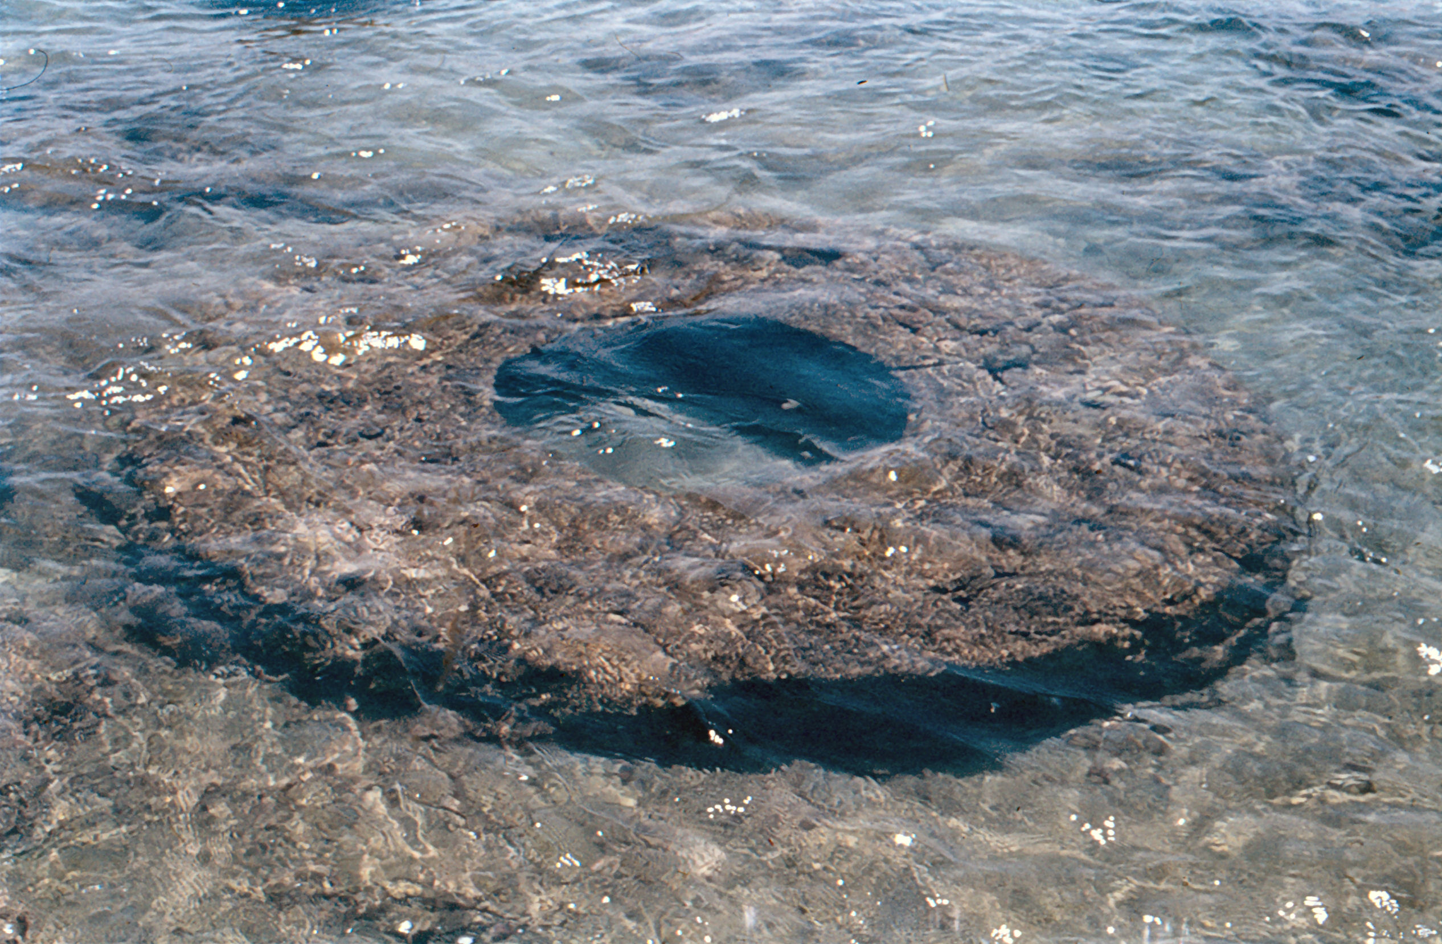
usage of the submarine groundwater discharge to the sea. Fresh submarine groundwater discharge is widely valued as a water resource for drinking, hygiene, agriculture, fishing, tourism, culture, or ship navigation. A first dam was built in the karst galleries near Marseilles, separating fresh and salty sea waters, after which fresh waters began to flow into the urban water supply system (Marseilles experience). There are reserves of fresh submarine groundwater discharge under the Sea of Azov, according to preliminary estimates of about 0.5–1.2 billion m³, but water turned out to be conditionally drinking. This low–mineralized water can be used only for the technical purposes: irrigation, heating and cooling systems. Water can be used as drinking only after filter treatment and sufficient disinfection;

Slide 17
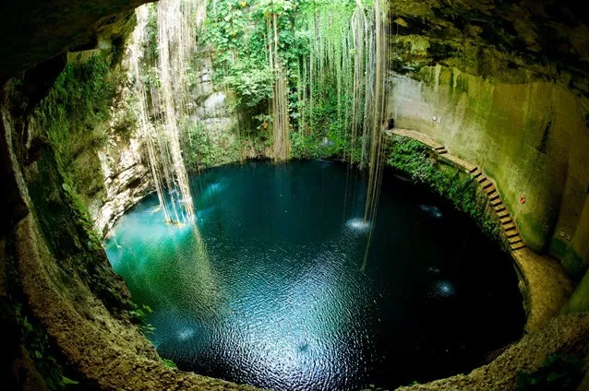
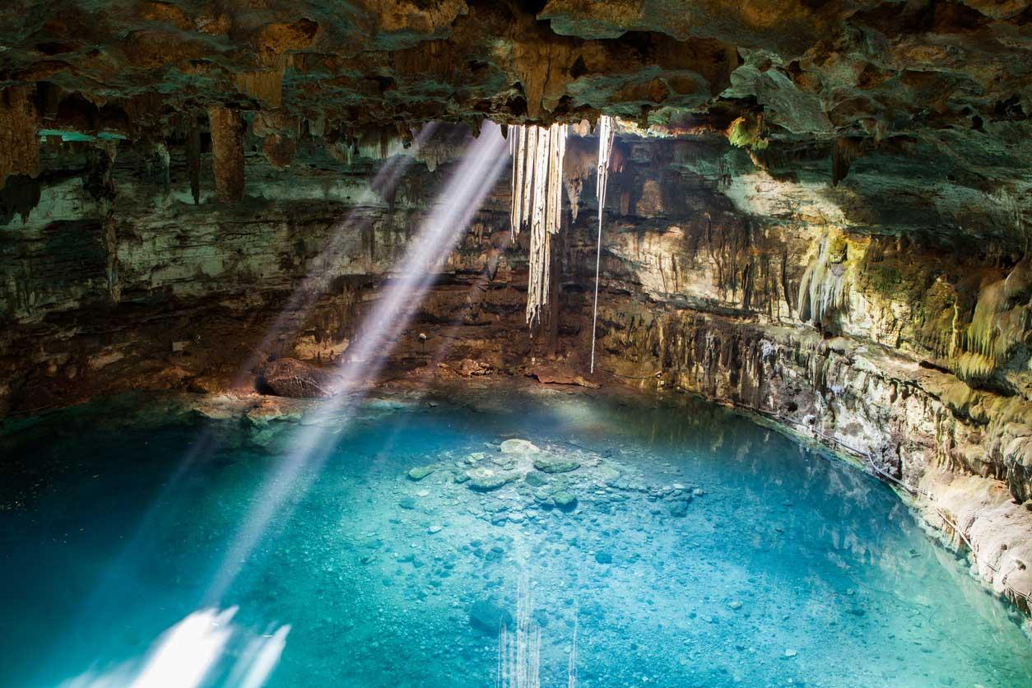
large–scale collection of precipitation in the mountainous Crimea, using karst cavities as underground water reservoirs (underground water collectors). The maximum water accumulation is in spring (February–March), and by the summer the water level in the cave decreases.
For example, the accumulated water in the caves of the Karasu–Bashi gorge is discharged through narrow karst tunnels. At the exit from the cavities, water channels are laid to supply fresh water to Bilogors`k;

Slide 18
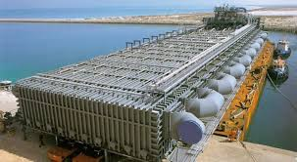
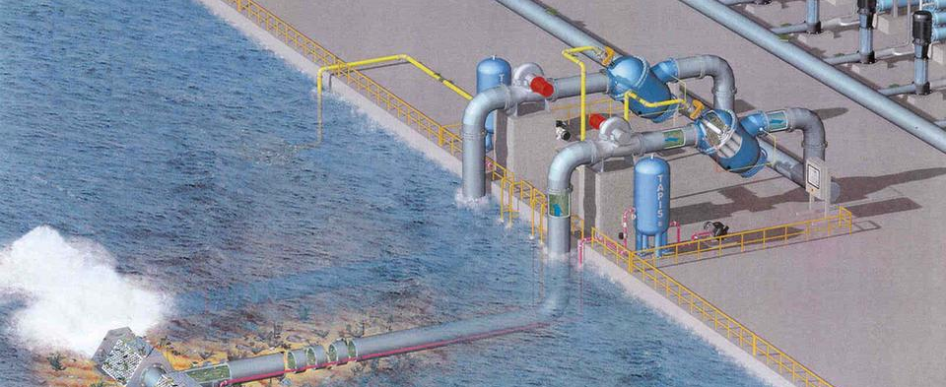
desalination of brackish groundwater and seawater. Selection of the appropriate technology of brackish groundwater and seawater desalination should be made based on water, energy consumption, brine disposal, as well as environmental risks and cost considerations. Dumping this concentrate can cause it to seep into the groundwater and degrade it. The membrane–based desalination technologies are used in treating brackish groundwater of the Crimea. For example, a desalination plant was built on the seashore in the Mykolaivka village and expected to be producing 40,000 m³ of water per day.

Slide 19
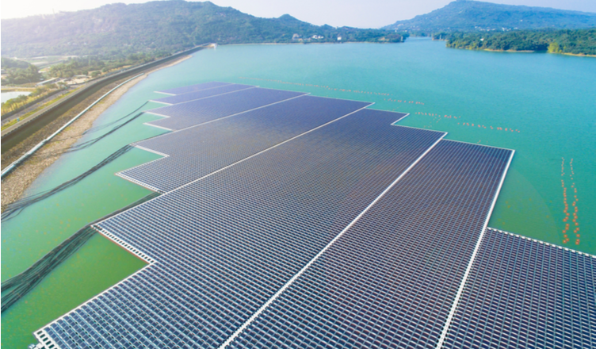
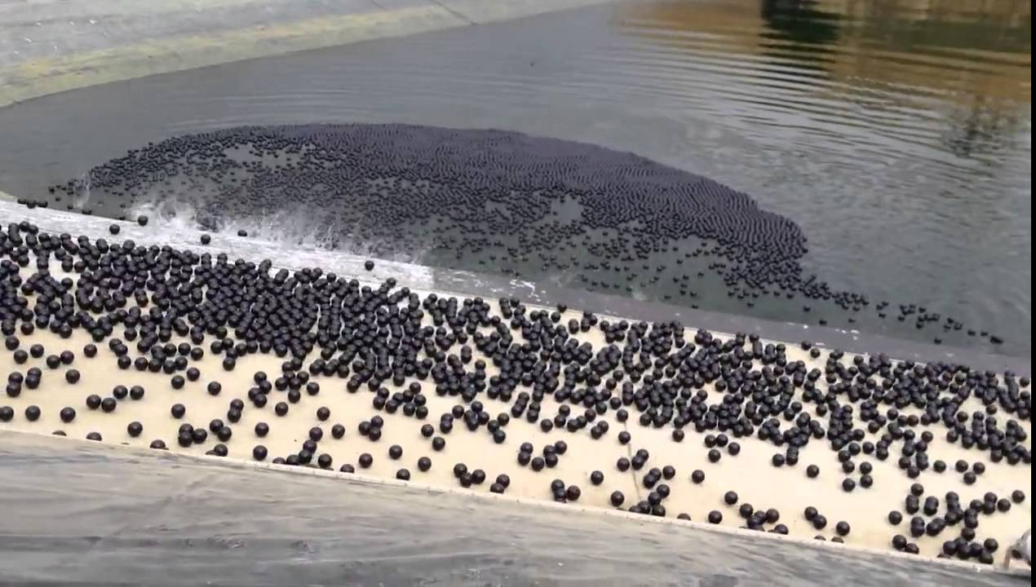
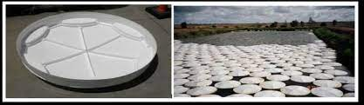
reduction of water losses due to evaporation in reservoirs. In summer, in semi–arid regions, water losses increase due to evaporation from the surface of reservoirs. Partial coverage of reservoirs with the floating elements to suppress evaporation losses is applied. For example, to solve the problem of evaporation in the United States, special black plastic balls were used, which covered the surface of reservoirs in California. This made it possible to reduce the evaporation of water from the surface of reservoirs by 85%. In south-eastern Spain, fabric materials have been used to reduce reservoirs evaporation, reducing water loss by 70–80% in water–scarce conditions. Also, an indirect effect of such protection against evaporation is a decrease in the concentration of salts in the water, which reduce the rate of soil degradation during irrigation.

Slide 20
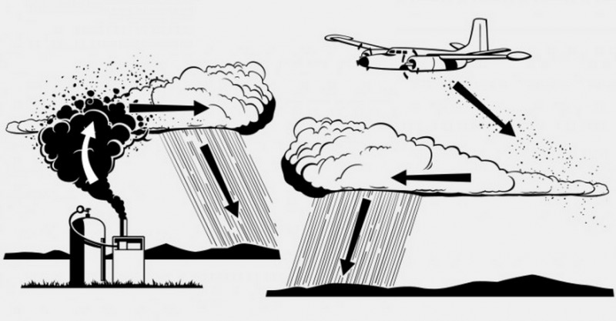
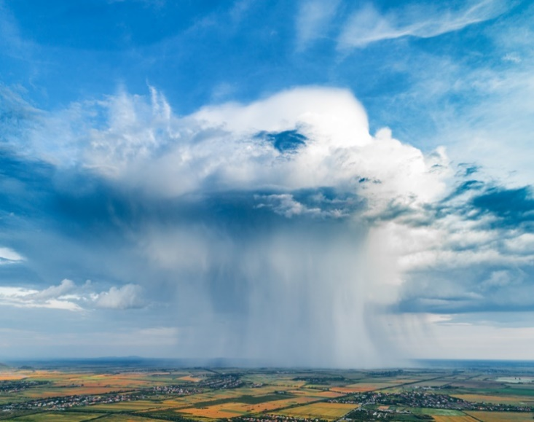
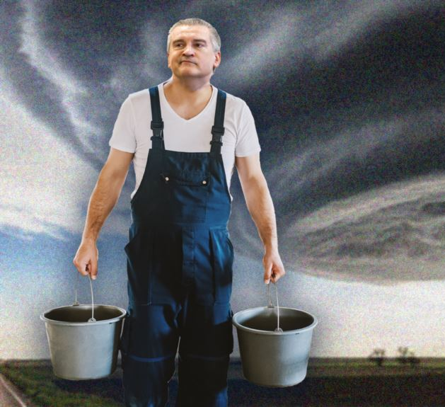
Artificially Increasing Atmospheric Precipitation: Analysis of Crimean Experience

Slide 21
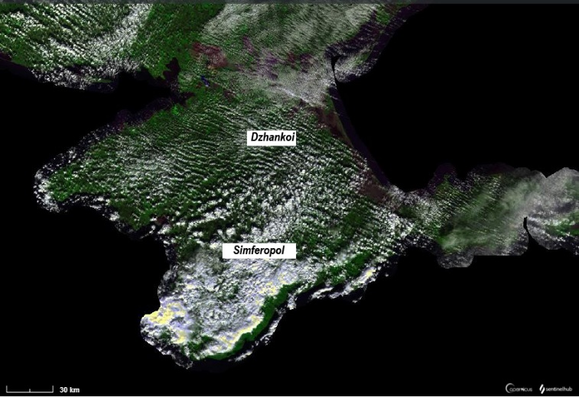
Active influences on atmospheric processes in September 2020
The daily variation of the cloud cover thickness (1—scale on the left), relative air humidity (2—scale on the left) and the amount of precipitation (3—scale on the right) at the Simferopol meteorological station for the period from October 28 to November 2, 2016, as a result the passage of the cold front through the Crimean Peninsula and active influences on the atmospheric processes.
Satellite image of cloudiness (Proba–V) during the passage of the cold front through the Crimean Peninsula and after the active influences on the atmospheric processes on October 30, 2016.

Slide 22
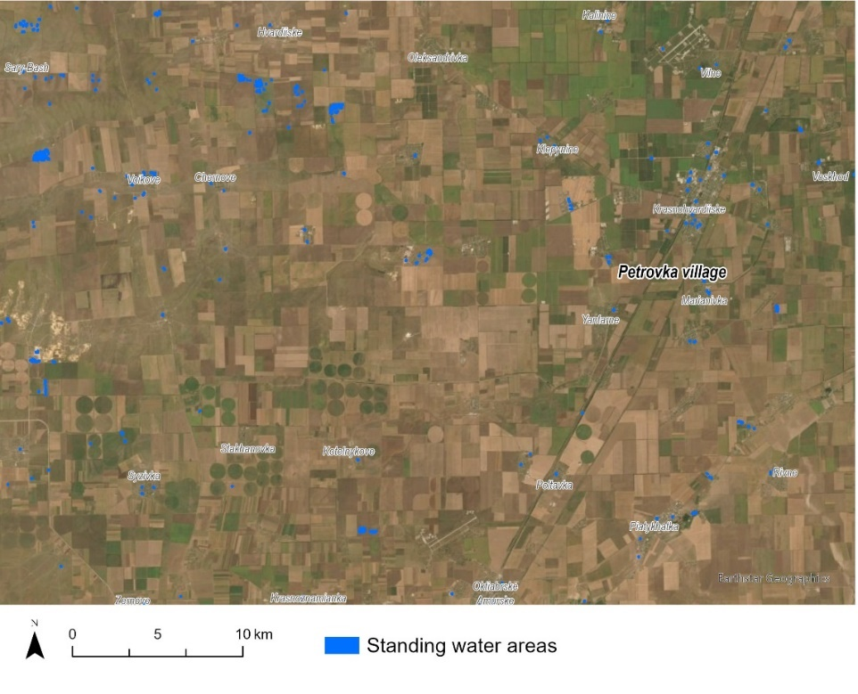
Map of the wet soil areas (blue color) as a result the passage of the cold front through the Crimean Peninsula and active influences on the atmospheric processes near Petrovka village, Krasnogvardeisky district, in 30 October 2016.

Slide 23
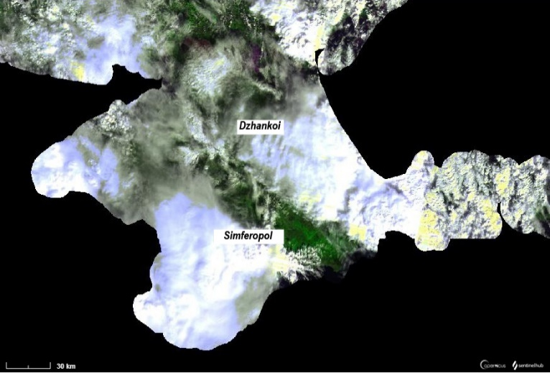
Active influences on atmospheric processes in September 2020
The daily variation of the cloud cover thickness (1—scale on the left), relative air humidity (2—scale on the left) and the amount of precipitation (3—scale on the right) at the Simferopol (A) and Dzhankoy (B) meteorological stations for the period from 28 September to 2 October 2020, as a result the passage of the cold front through the Crimean Peninsula and active influences on the atmospheric processes.
Satellite images of cloudiness (Proba–V) during the passage of the Balkan cyclone and the associated cold and after the active influences on the atmospheric processes on 30 September.

Slide 24
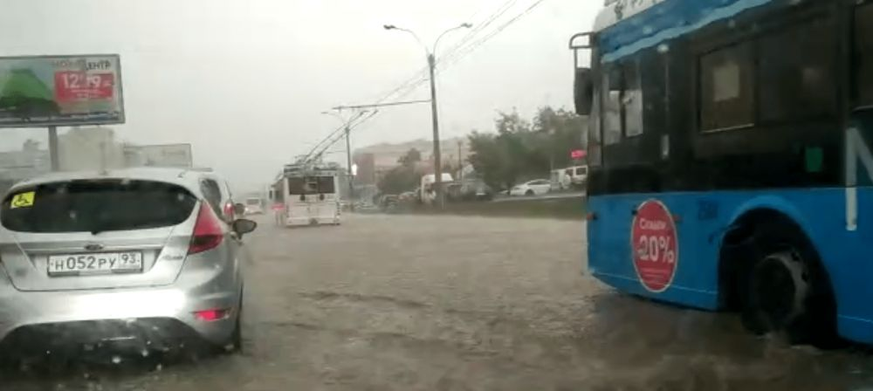
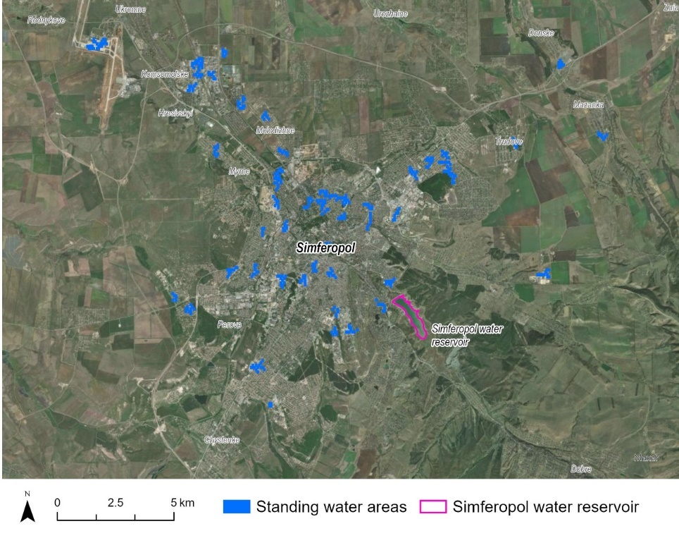
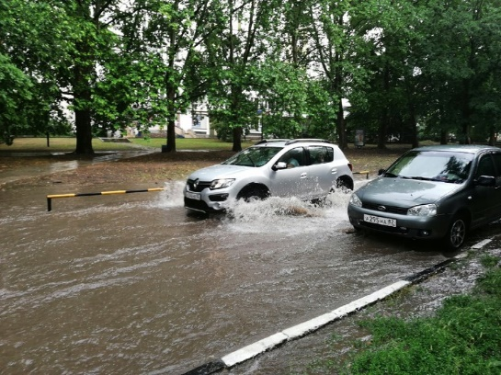
Map of standing water areas and the water surfaces areas of Simferopol reservoir near Simferopol city as a result of the passage of the cold front through the Crimean Peninsula and active influences on the atmospheric processes on 30 September 2020.

Slide 25
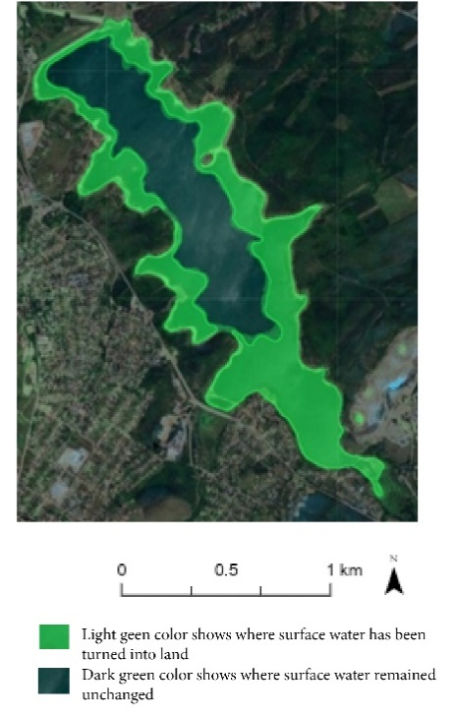
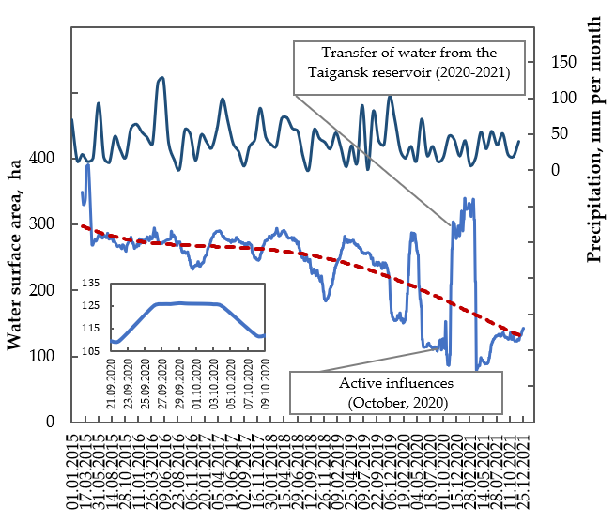
Decrease in the water surface area of the Simferopol Reservoir in 2021 (dark green) compared to 2010 (light green) according to Landsat satellite imagery (A) and dynamics of changes (B) for the period 2015–2021 according to Sentinel–1 radar satellite data (the period of 18.09–10.10.2020 is shown in the small graph frame).

Slide 26
Conclusions
Significate increasing water use and consumption (intensification of construction, industry, tourism and militarization) and the cessation of fresh water supplies from mainland Ukraine has reduced the water level in some reservoirs to a critical level, while climate change has exacerbated this situation. The lack of fresh water negatively affects the agriculture productivity and soil quality, which leads to financial losses and changes in traditional farming. In general, the complexity of the situation is associated with inefficient management decisions of the occupation authorities along with the intensification of militarization of the Cri-mean Peninsula.
Boychenko, S.; Kuchma, T.; Khlobystov, I.V. Changes in the Water Surface Area of Reservoirs of the Crimean Peninsula and Artificial Increases in Precipitation as One of the Possible Solutions to Water Shortages. Sustainability, 2022, 14, 9995. https://doi.org/10.3390/su14169995
Boychenko S., Voloshyn S., Kuchma, T., Pozniak O., Khlobystov, Ie. Ecological and Climatic Discrimination in the Occupied Crimea: Dimensions and Threat. NGO: Crimean Tatar Resource Center, 2022, p. 115. https://10.5281/zenodo.6998964
Boychenko, S., Kuchma, T. About the Efficiency of Active Influences on the Atmospheric Processes Aiming at the Artificial Increase of Precipitation over the Crimean Peninsula in September 2020. Third International Conference: “Recent trends in the development of information systems and telecommunications technologies” (Kyiv, Ukraine: 2021). Kyiv: NYFT. 2021, 13–16. https://zenodo.org/record/4540480#.YZTDSWDP02w.

Slide 27
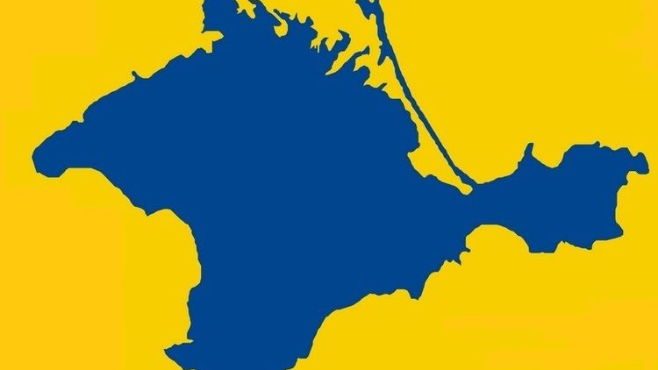
Thank you!

